Slide 1
Digital Transformation: Introduction & Where to start
Associate Professor. Nguyen, Quang Trung
Dr Dang Pham Thien Duy
Managing Smart Transformation Research Cluster
School of Business and Management
RMIT University
Senior Lecturer, HDR Coordinator
School of Business and Management
RMIT University

Slide 2
Outline
What is digital transformation?
Why do you need to change?
Critical factors in managing transformation capability
Critical factors in digital capability
Where to start

Slide 3
DIGITISATION
(số hóa)
Converse analogue data to digital data so that computers can store/process/transmit such information Converting CD or VHS tape to MP3;​ handwritten into digital form​.
DIGTALISATION
(số hóa)
Change in how people interact: domains of social life are restructured around digital communication and media infrastructures:
Mail to Email or telephone calls to Social Media flatform​
Process of moving to a digital business​
Automation (shifting work roles or transforming business processes)
DIGITAL TRANSFORMATION
(chuyển đổi số)
Use digital data and systems to transform how the enterprise interacts with its ecosystem of staff, customers and suppliers to enable the firm to enhance its operational capacity, improve customer experience by increasing value creation and developing new business models.

Slide 4
Change before you have to
The wise men learn from the mistakes of others (Bismarck)

Slide 5
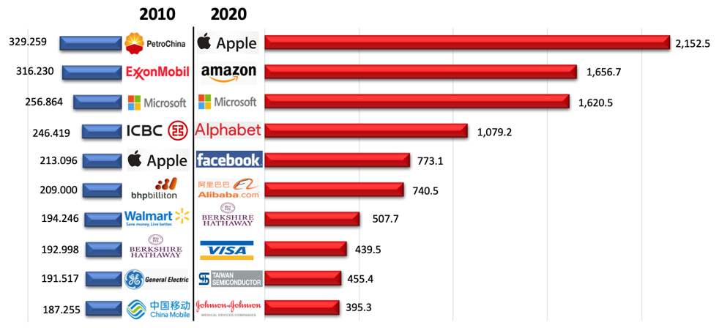
Technology-based firms are on the rise ​
Sources: FT (2010) and Gogsofthedow (2020) ​
Wisest men of all learn from others' successes (Maxwell)
Notes:
‘One day, Amazon will fail’ but our job is to delay it as long as possible: https://www.cnbc.com/2018/11/15/bezos-tells-employees-one-day-amazon-will-fail-and-to-stay-hungry.html
Half a century ago, the life expectancy of a firm on the Fortune 500 was about 75 years. Today it’s less than 15 years and declining further. https://news.microsoft.com/transform/starting-a-digital-transformation-what-you-must-get-right-from-start/

Slide 6
WHY?
Our clients have changed ​
Before you know it, you become irrelevant​
Several giants have gone​ ​
Hire fewer people but grow exponentially through technology (WhatsApp, YouTube, Instagram …)​
It is happening in all industries​
Disruption has become the new normal

Slide 7
WHAT?
Customer Experience
Operation
Business Model
Customer Understanding
Process Digitalisation
Digitally – Modified Business
Top Line Growth
Worker Enablement
New Digital Business
Customer Touch Point
Performance Management
Digital Globalisation

Slide 8
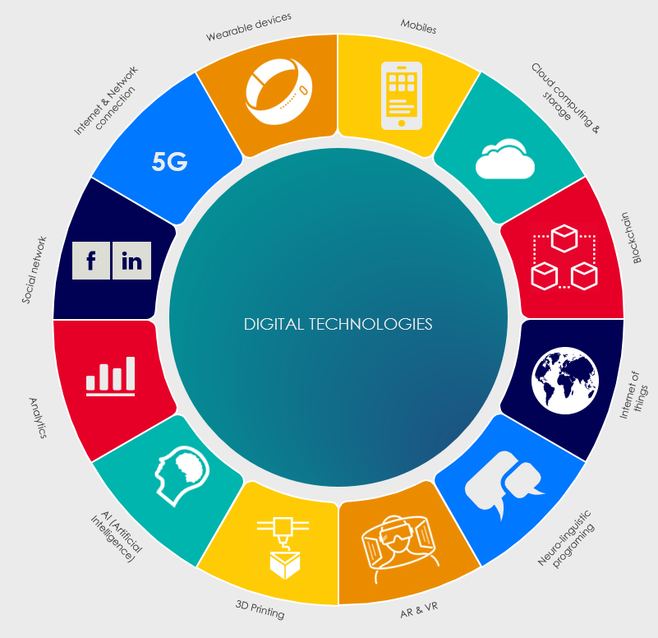
WHICH TECHNOLOGY
New tech comes faster than you think
Must embrace the challenge of relevance

Slide 9
WHEN?
Are you driving change or are you being driven by it?
Transform the core business
“Get closer than ever to your customers. So close that you tell them what they need well before they realize it themselves.
”
- Steve Jobs -
Look for a new model
Technology is no longer a luxury but a requirement

Slide 10
HOW?
Focus on the DNA of Digital Transformation
Managing transformation capability
Digital capability

Slide 11
MANAGING TRANSFORMATION CAPABILITY ​
Governance
Strategy
Culture
Awareness
Resource allocation commitment
Digital champion
Communication
Collaboration
Business model renovation
Plan clarity
Defined roles and responsibilities
KPIs
Consistency
Knowledge sharing
Risk taking
Challenge and failure embracing
Co-creation
Openness to learn

Slide 12
DIGITAL CAPABILITY
Technology & Cybersecurity
Data analytics
Competencies
Network & Platform
Piloting new technologies
Multi-channel interaction
Digitalized Product & Service
Cybersecurity tools
IT solution outsourcing
Data standardisation
Data as assets
Operational data
Real-time data
Customer data analysis
Data insight-driven business
Personalisation
Tech-savvy staff
Reskilling
Upskilling
Digital expertise
Partnerships

Slide 13
PRIMARY STAGE
Governance
Strategy
Culture
Primary stage - Description
Little or no awareness of Digital Transformation (DT)
No clear funding and resource allocation mechanism for DT
There is little existence of culture that is conducive for digital transformation
No clear consistent plan
Roles and responsibilities are not defined
Technology & Cybersecurity
Data Analytics
Competencies
There is little or no investment in IT infrastructure
There is little existence of technological assets to generate data
No value generated from data
There is little competence in technology and data handling

Slide 14
INTERMEDIATE STAGE
Governance
Strategy
Culture
Intermediate stage - Description
There is management accountability and willingness for DT, but dominantly at a tactical level
Prevalence of short and medium focus of digital benefits
People in all levels are willing to adopt digital technologies
A few tactics and strategies are in place to leverage digital transformation
Strategies are not well aligned to the digital vision
Technology & Cybersecurity
Data Analytics
Competencies
Digital processes and initiatives are generally in place to generate value
IT infrastructure is developed in separate modules
Data is collected for eventual needs
Data is generated in silos
Inconsistent employee understanding and use of digital tools
There is no formal digital training

Slide 15
Governance
Strategy
Culture
ADVANCED STAGE
Advanced stage - Description
There are clear policies, leadership and ownership of DT
Digital risk and opportunity are well considered at the board level
The digital agenda is shared across the organisation
Digitally-related KPIs are well set
The relationship between KPIs and business drivers is clearly addressed
Digital learning becomes part of the organisation’s culture
Willingness and readiness to embrace new things becomes part of the organisation’s value
Technology & Cybersecurity
Data Analytics
Competencies
Technology and business work in a collaborative way
Platform business is embraced
There are processes for administrative control of the system
There are protocols to manage data access
Data is collected and shared
Data is analyzed to optimize business processes and obtain customer insights
Training and learning activities are formally facilitated
Partnerships are established for further knowledge

Slide 16
Governance
Strategy
Culture
DIGITALLY MATURED STAGE
Digitally mature stage - Description
Digital-first approach is applied to all business issues
Digital development is a well-embedded practice at all levels of the organisation
Governance is steered towards building a digital business
The organisation has executive accountability for digital planning
Digital investment becomes a significant investment as part of the company’s strategic planning
Absolute consistency and clarity of digital vision is ensured
Technology & Cybersecurity
Data Analytics
Digital learning becomes part of the organisation’s culture
Willingness and readiness to embrace new things becomes part of the organisation’s value
Competencies
Tools can work automatically and accordingly to the information received
Digital tools can interact together to optimize process
Business and technology are fully aligned
Compliance to procedures of cybersecurity is strictly demanded
Employees can consistently use digital tools as a matter of course in their daily work
A training strategy is clearly articulated
Partnerships are established to proactively generate new knowledge
Customer-centric insight becomes a core competitive advantage of the organisation
Collected data is transparent and shared across the organisation
Data plays an increasing role in decision making

Slide 17
Where to Start

Slide 18
Jeff Bezos, founder of Amazon, talked about the firm ‘inevitable death’ three times between 2013 and 2018?
Source: Business Insider 2021

Slide 19
Why was Jeff Bezos obsessed about that?

Slide 20
Start with leaders:
What you do and who you should be
Top-down approach and CEO not CTO
Live with integrity and lead by examples
Develop a winning strategy with a great leadership team
First step is to create a digital culture and embrace challenges and micro-revolutions
Ask yourself this question: When was the last time that you learn something new for the first time?
Notes:
Michael Dell : one cannot do anything.

Slide 21
Start with a Digital Plan
Create sense of urgency
Identify existing pain points
Determine relevant digital strengths
Frame the digital challenge
Determine aspiration level
A culture of trust is a culture of innovation
John Hamm

Slide 22
Five areas of focus
Analog | Mass market with one-way comms and value flow from firm to customer | Rivalry with similar firm in well-defined industries with fixed boundaries | Use structured data to improve and manage operations | Only test finished products. Minimize innovation failure | Improve or refine existing biz model
Digital | Dynamic networks with two-way comms and reciprocal value flows | Blurred and fluid lines between industries and between partners vs rivals | Use big data or unstructured data to solve problems and drive innovation | Test new ideas quickly/cheaply via iterative learning and experiments | Adapt value prop to stay relevant to evolving customer needs and landscapes
 | Harness Customer Experience | Build Platforms, Not Just Products | Convert Data Into Assets | Innovate With Rapid Experi-mentation | Adapt Your Value Proposition
Customer
Competition
Data
Innovation
Value
Source: David Rogers (2016)
Notes:
Bố trí lại để neu dc thông điệp ở hàng cuối cùng

Slide 23
Overcome common barriers
Lack of clear definition
Too many other changes
Poor implementation
Employee resistance
Unclear governance
Source: Paula Alsher (2013)

Slide 24
GOOD NEWS!
Technology cannot replace humans
Several job types are lost but more new jobs will be created
See more in this article "5 lý do thất bại trong chuyển đổi số của các doanh nghiệp Việt Nam" - Five causes of digital transformation failure in Vietnamese firms
Small size firms can be more agile than larger firms
We are aware of the challenges
We can no longer say: "we don’t know what we don’t know

Slide 25
Thank you!

